Slide 1

Android Notification
Charles_liu@realisil.com.cn
劉 闖

Slide 2
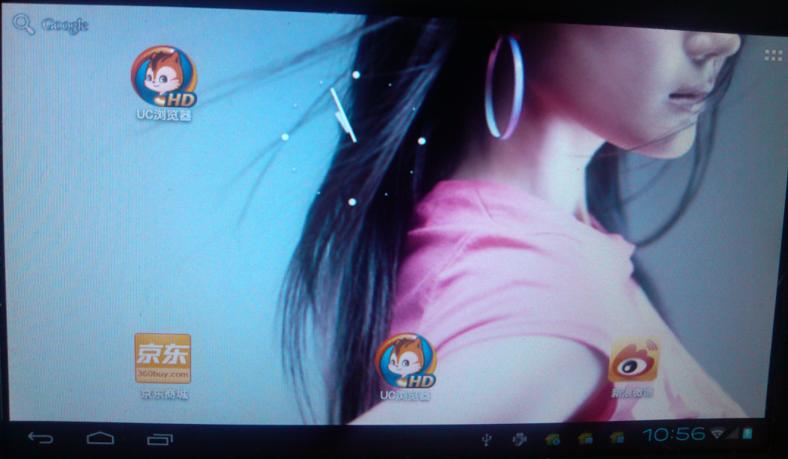
Notification’s icon layout view

Slide 3
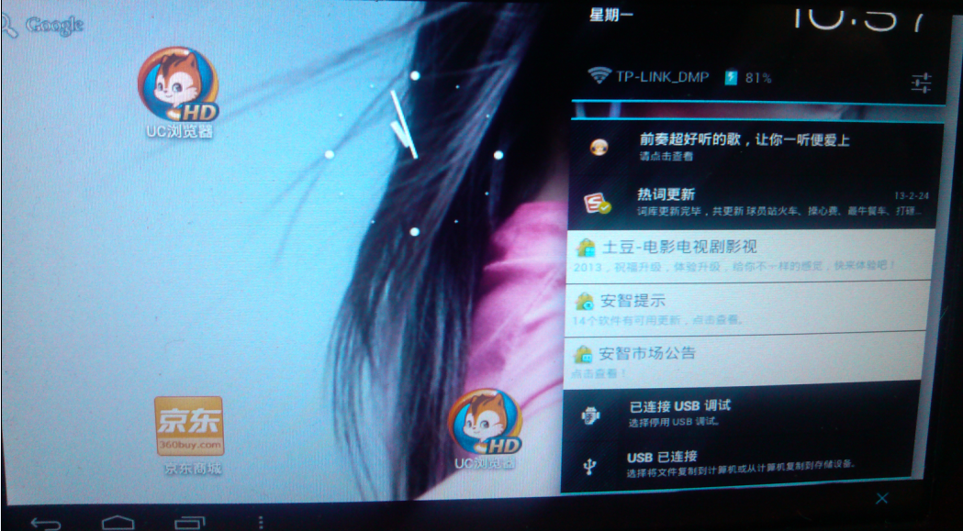
Notification’s panel layout view

Slide 4
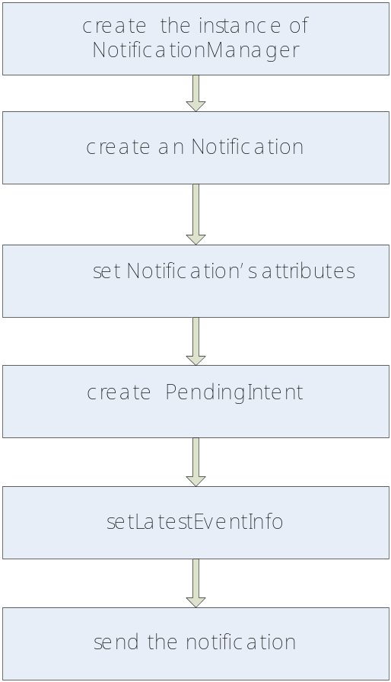
App Send Notification
Steps：
1.create the instance of NotificationManager nm，which can send and cancel an Notification
  NotificationManager nm = (NotificationManager)getSystemService(Context.NOTIFICATION_SERVICE);
2.create an Notification:
Notification m_Notification=new Notification();
3.set Notification’s attributes
  //icon
  m_Notification.icon=R.drawable.icon;
  //notice content
  m_Notification.tickerText=".....";
  //default sound
  m_Notification.defaults=Notification.DEFAULT_SOUND;
  //default virbrate
  m_Notification.defaults=Notification.DEFAULT_VIRBRATE;
  //default light
  m_Notification.defaults=Notification.DEFAULT_LIGHTS;
  //Notification.DEFAULT_All=default sound + default virbrate + default light
  //set when to send
  m_Notification.when = System.currentTimeMillis()

Slide 5
App Send Notification
Steps：
4.create PendingIntent
  PendingIntent contentIntent = PendingIntent.getActivity(this, 0, new Intent(this, ActivityMain.class), 0);
5. setLatestEventInfo
  m_Notification.setLatestEventInfo(this, “title”, ”content”, contentIntent);
6. send notification
  Nm.notify(1,m_Notification);

Slide 6
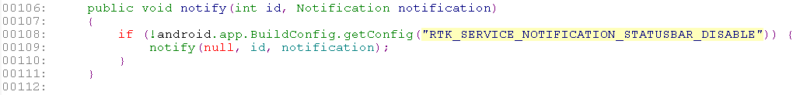
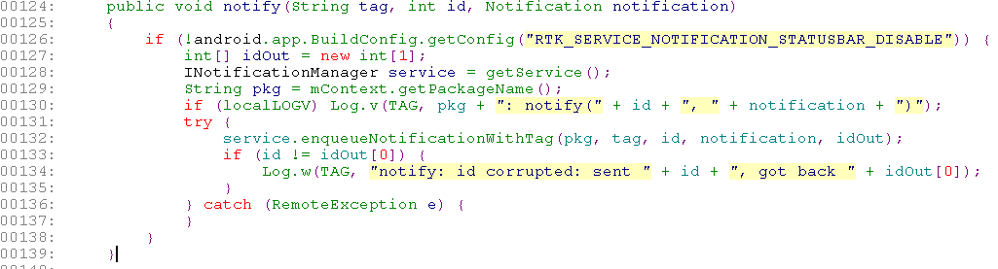
NotificationManager process notification
//NotificationManager.java

Slide 7
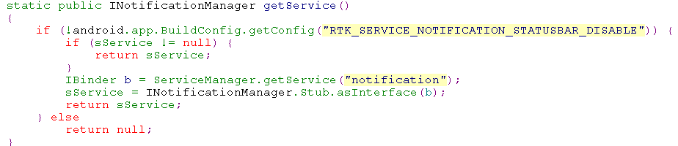
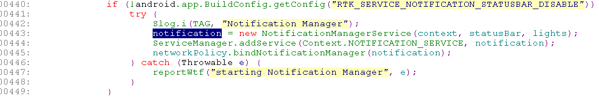
NotificationManager process notification
//NotificationManager.java
SystemServer.java

Slide 8
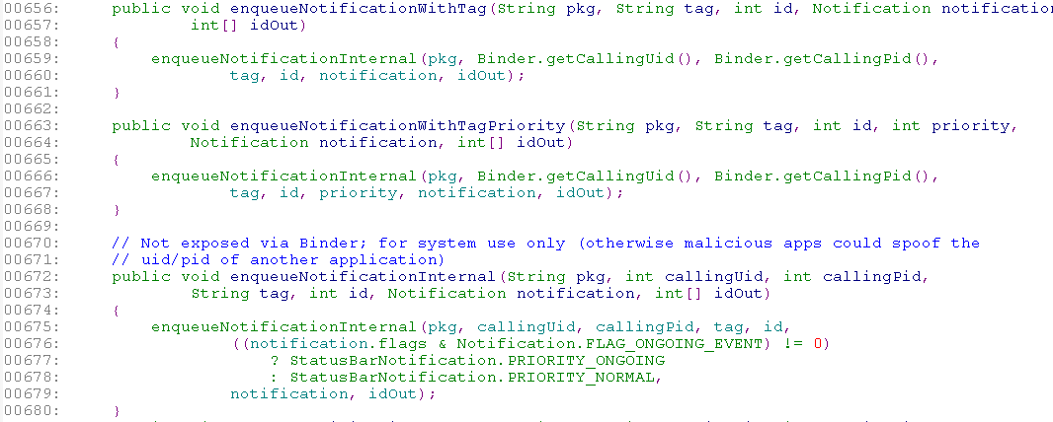
NotificationManager process notification
//NotificationManagerService.java

Slide 9
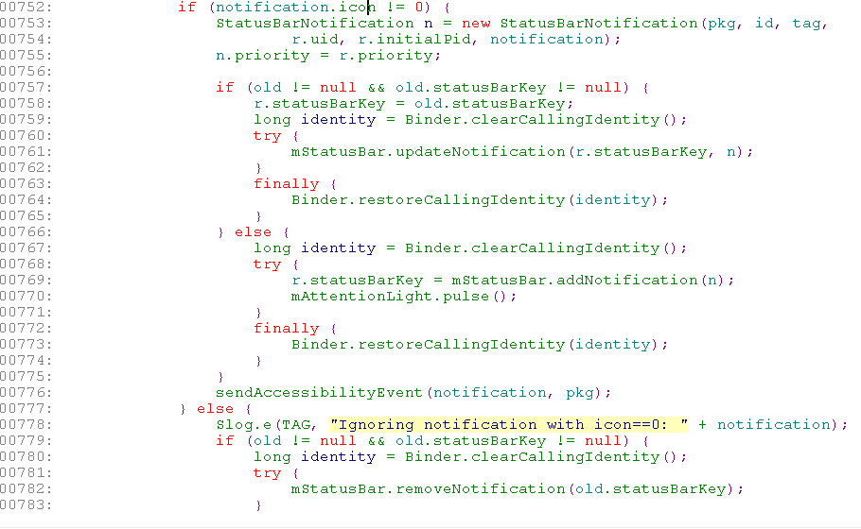
NotificationManager process notification
//NotificationManagerService.java

Slide 10
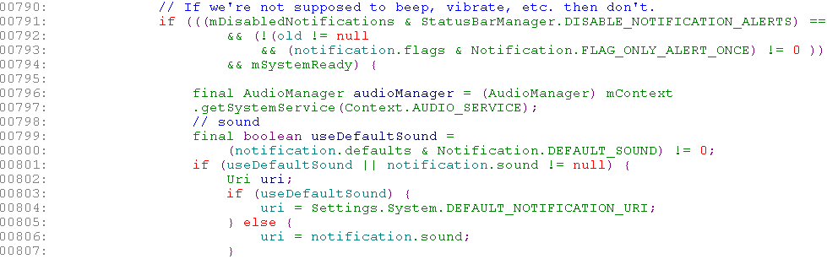
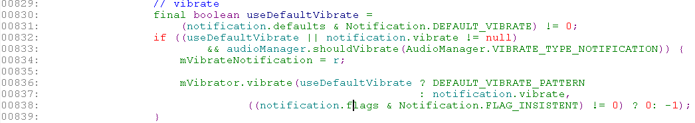
NotificationManager process notification
//NotificationManagerService.java add effect of sound | vibrate | lights

Slide 11
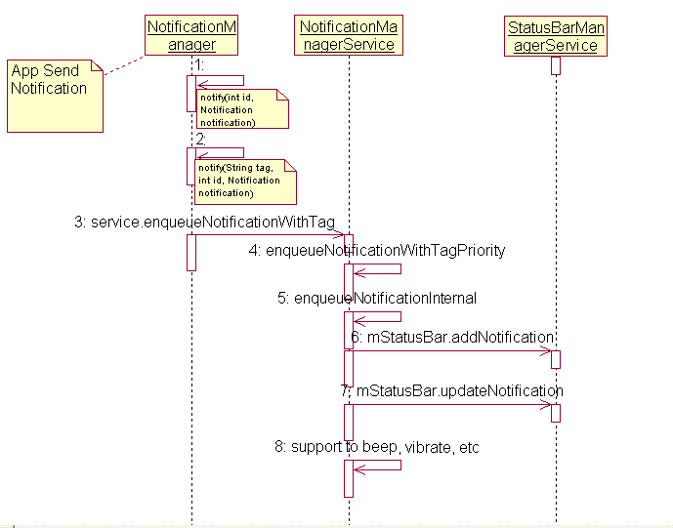
NotificationManager process notification
sequence diagram

Slide 12
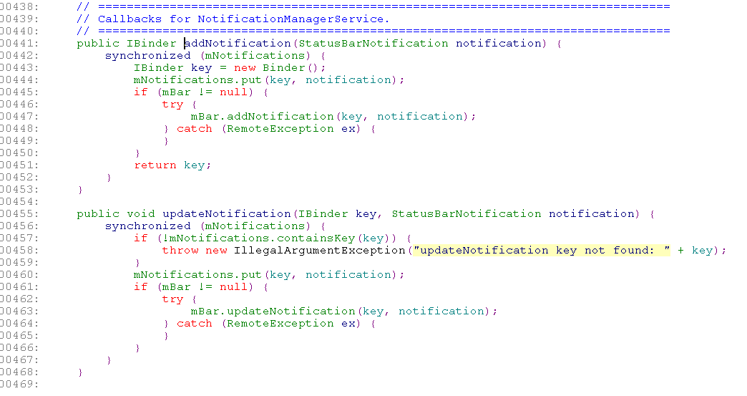
StatusBarManager process notification
//StatusBarManagerService.java

Slide 13
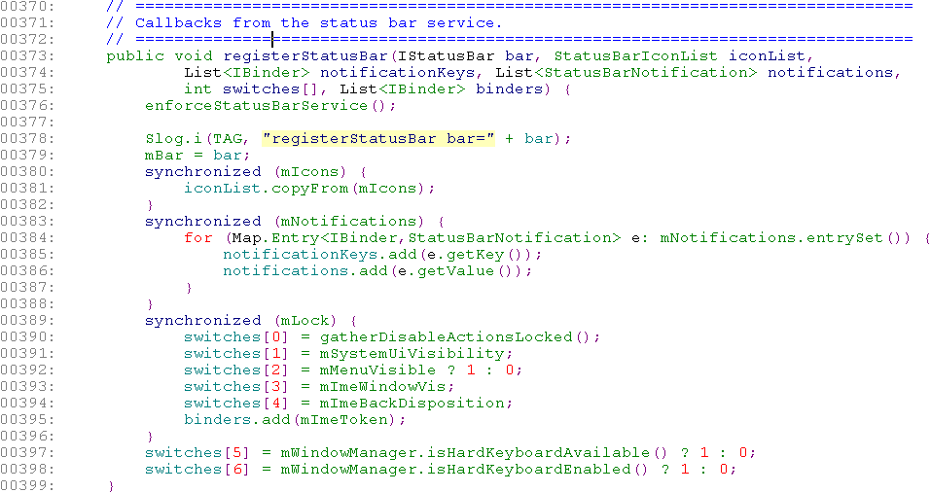
StatusBarManager process notification
//StatusBarManagerService.java
mbar是StatusBar call registerStatusBar传入的一个callback

Slide 14
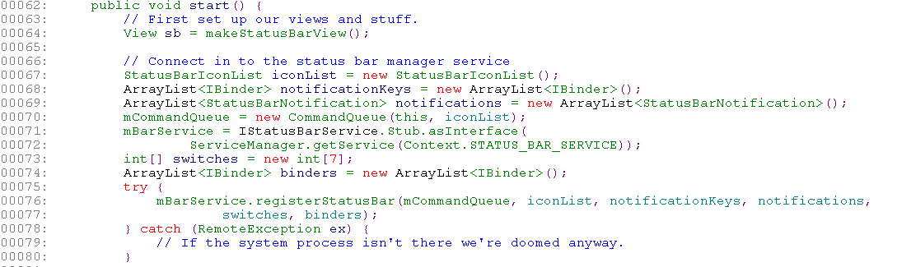
StatusBarManager process notification
//StatusBar.java
class StatusBar extends SystemUI implements CommandQueue.Callbacks
CommandQueue.Callbacks 的方法由StatusBar 的子类TabletStatusBar实现

Slide 15
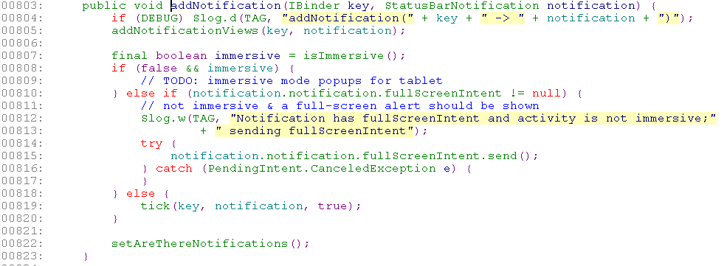
StatusBarManager process notification
//TabletStatusBar.java
StatusBarManagerService. addNotification----→TabletStatusBar. addNotification

Slide 16
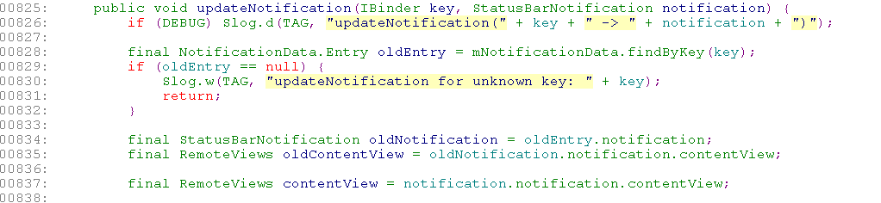
StatusBarManager process notification
//TabletStatusBar.java
StatusBarManagerService. updateNotification----→TabletStatusBar. updateNotification

Slide 17
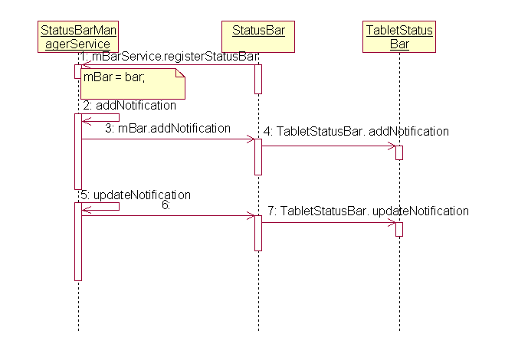
StatusBarManager process notification
sequence diagram

Slide 18
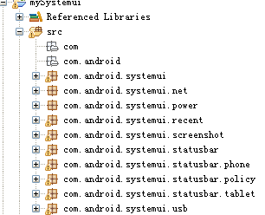
Systemui 分析
Code structure

Slide 19
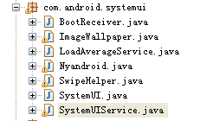
Systemui 分析
com.android.systemui structure

Slide 20
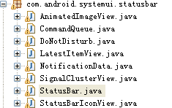
Systemui 分析
com.android.systemui.statusbar structure

Slide 21
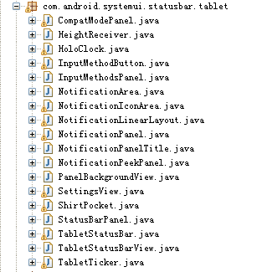
Systemui 分析
com.android.systemui.statusbar.tablet structure

Slide 22
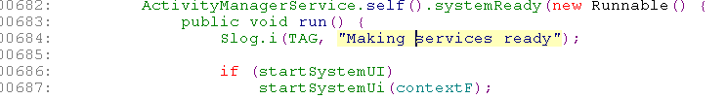
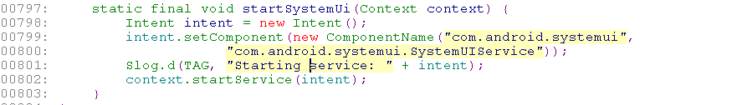
Systemui 分析
start systemuiservice （Systemserver.java）

Slide 23
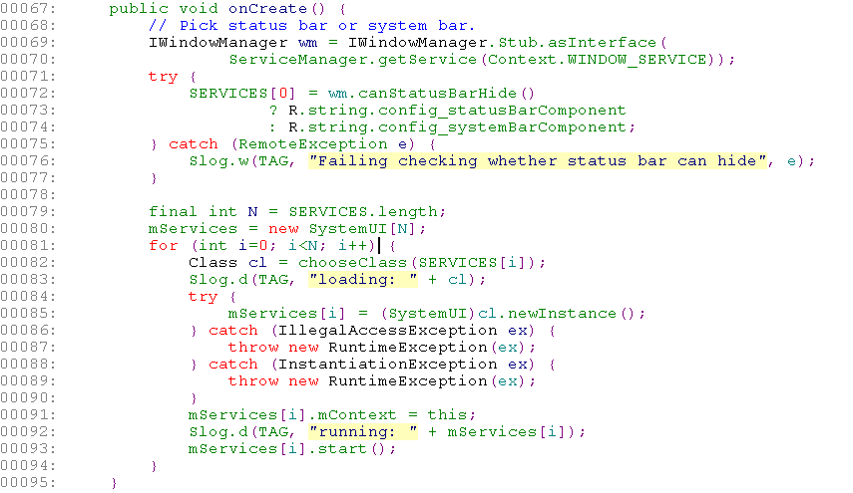
Systemui 分析
start systemui （SystemUIService.java）
run TabletStatusBar.start()
config.xml
<string name="config_statusBarComponent" translatable="false">com.android.systemui.statusbar.phone.PhoneStatusBar</string>
<string name="config_systemBarComponent" translatable="false">com.android.systemui.statusbar.tablet.TabletStatusBar</string>

Slide 24

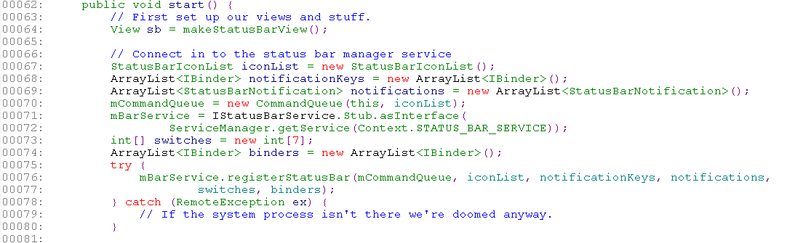
Systemui 分析
start （TabletStatusBar.java）
start （StatusBar.java）

Slide 25
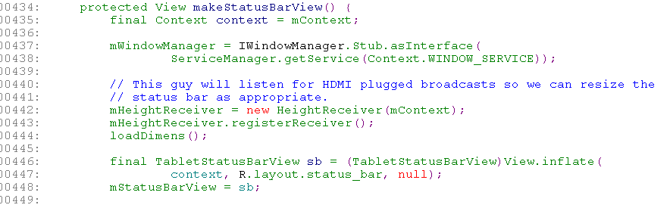
Systemui 分析
makeStatusBarView（TabletStatusBar.java）

Slide 26
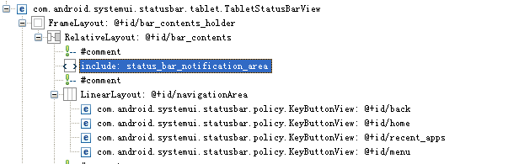
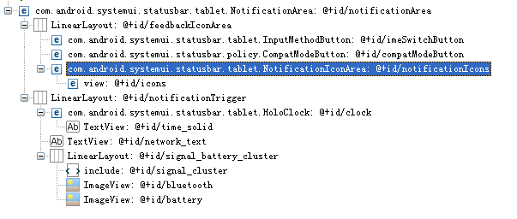
Systemui 分析
/res/layout-sw600dp/status_bar.xml
res/layout-sw600dp/status_bar_notification_area.xml

Slide 27
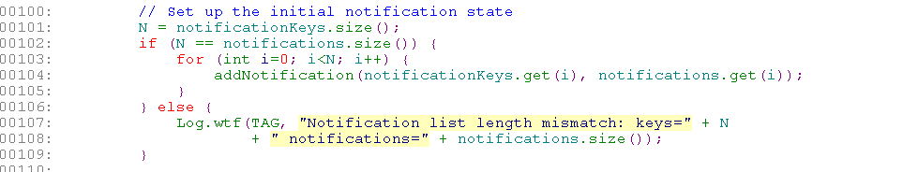
Systemui 分析
start （StatusBar.java）
Go TabletStatusBar. addNotification()

Slide 28
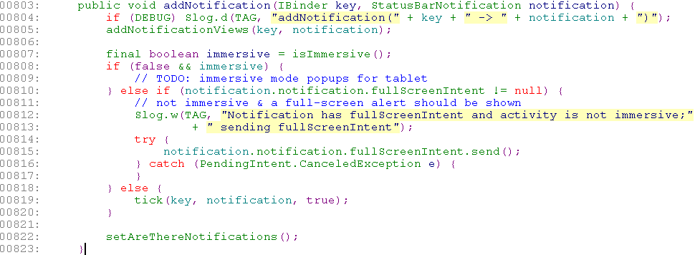
Systemui 分析
TabletStatusBar. addNotification()
1.addNotificationViews(key, notification);
2.setAreThereNotifications()

Slide 29
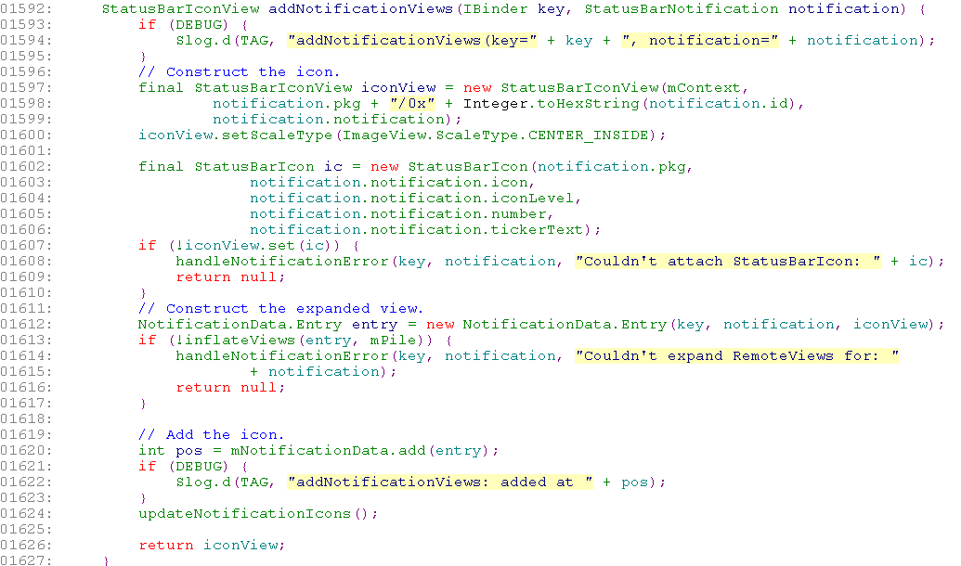
Systemui 分析
TabletStatusBar. addNotification()
1.addNotificationViews(key, notification);
1.1 set icons，1.2 set ExpanedView，1.3updateNotificationIcons

Slide 30
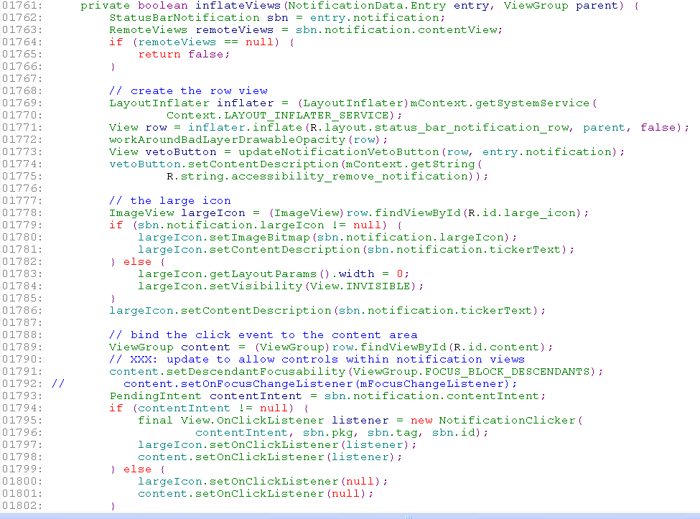
Systemui 分析
TabletStatusBar. addNotification()
1.2 set ExpanedView inflateViews()
Create row view and set icon
Get notification intent and set clicklistenser

Slide 31
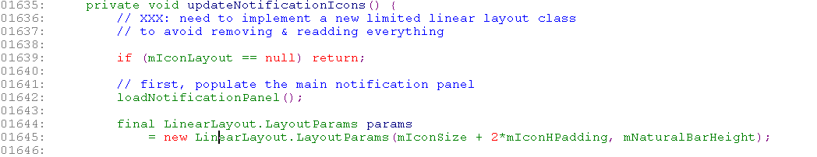
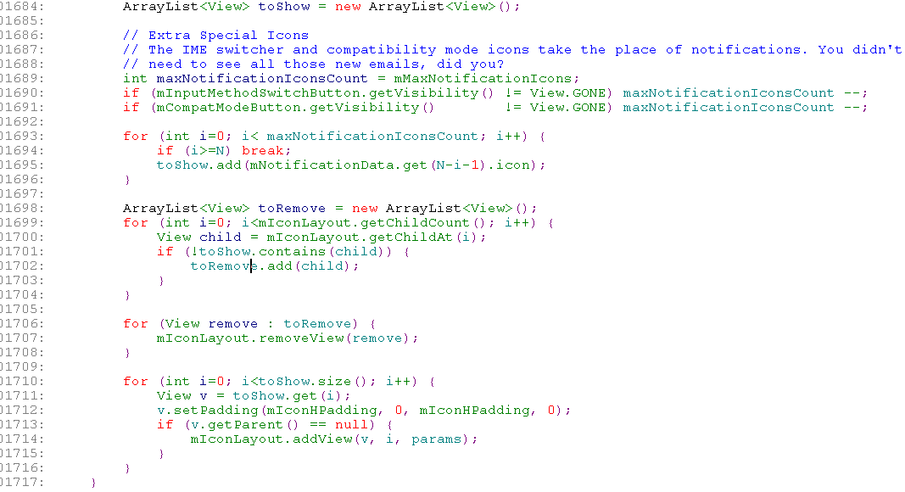
Systemui 分析
TabletStatusBar. addNotification()
1.3updateNotificationIcons()
Update mNotificationPanel
Remove or add icon from iconlayout

Slide 32
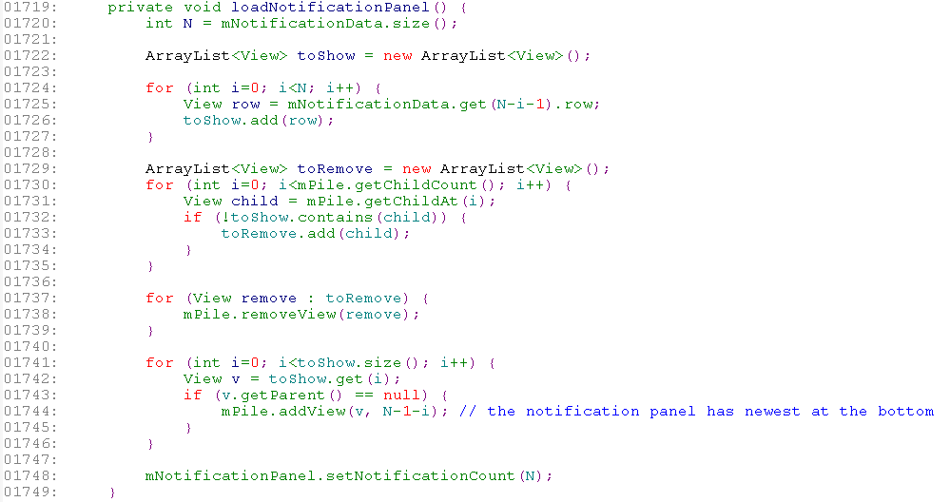
Systemui 分析
TabletStatusBar. addNotification()
1.3updateNotificationIcons() →loadNotificationPanel()
Remove or add notification content from NotificationPanel

Slide 33

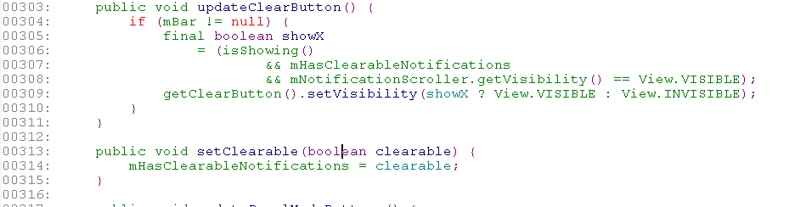
Systemui 分析
TabletStatusBar. addNotification()
2.setAreThereNotifications()
Set clearButton

Slide 34
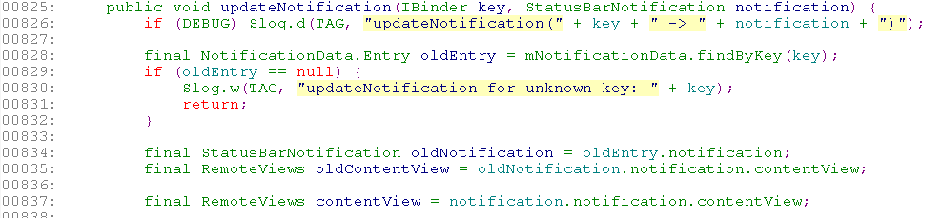
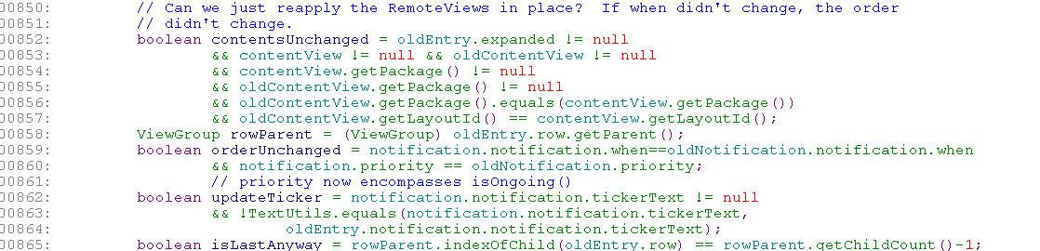
Systemui 分析
TabletStatusBar. updateNotification()

Slide 35
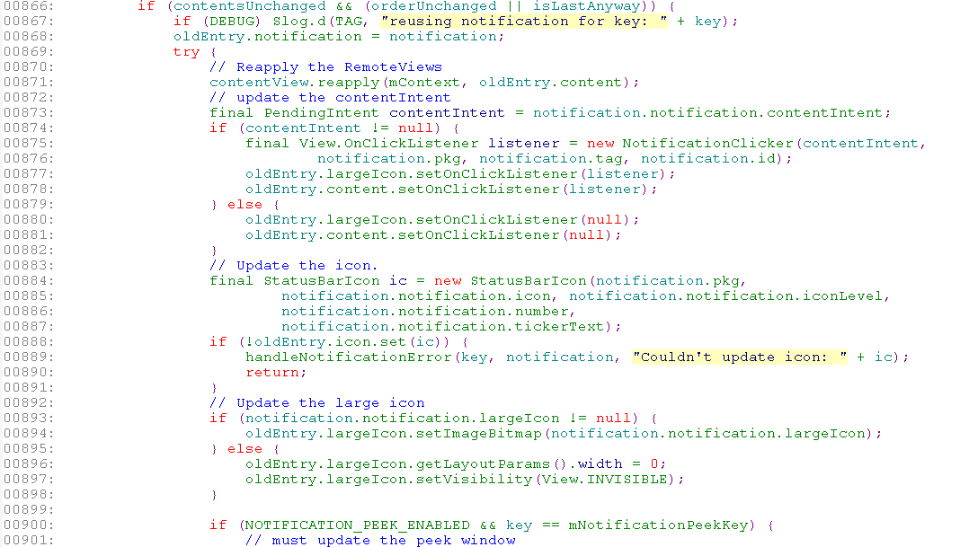
Systemui 分析
TabletStatusBar. updateNotification()

Slide 36


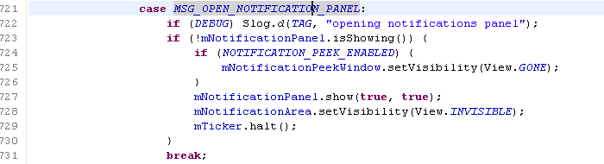
Systemui 分析
TabletStatusBar show notificationpanel
mNotificationPanel.show(true, true);

Slide 37
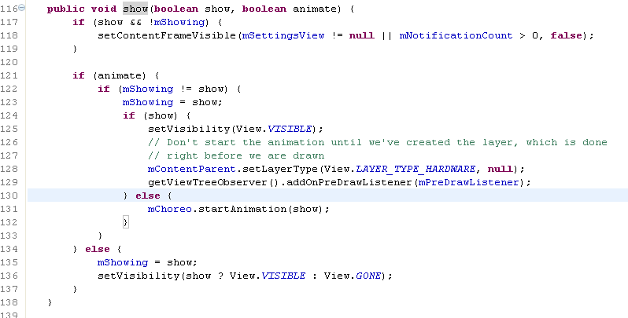
Systemui 分析
NotificationPanel.show

Slide 38
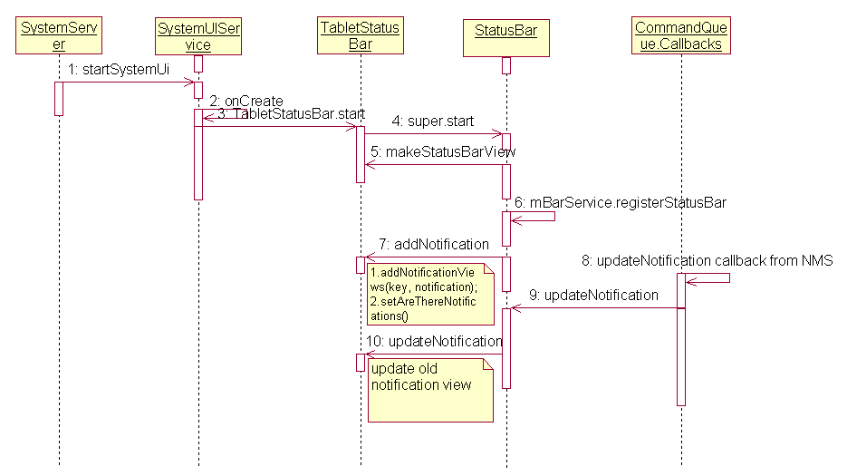
Systemui 分析
sequence diagram

Slide 39
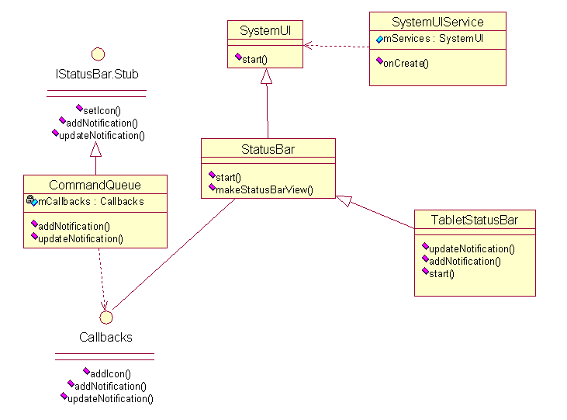
Systemui 分析
class diagram

